Slide 1

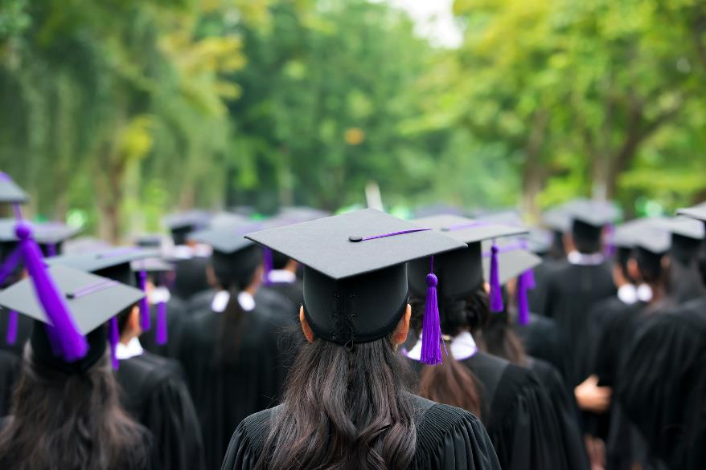
SD8 Kootenay Lake
District Dogwood
Scholarship Presentation
Thursday, April 6, 2023.
Presented by Tamara Malloff, District Principal, Innovative Learning Services

Slide 2
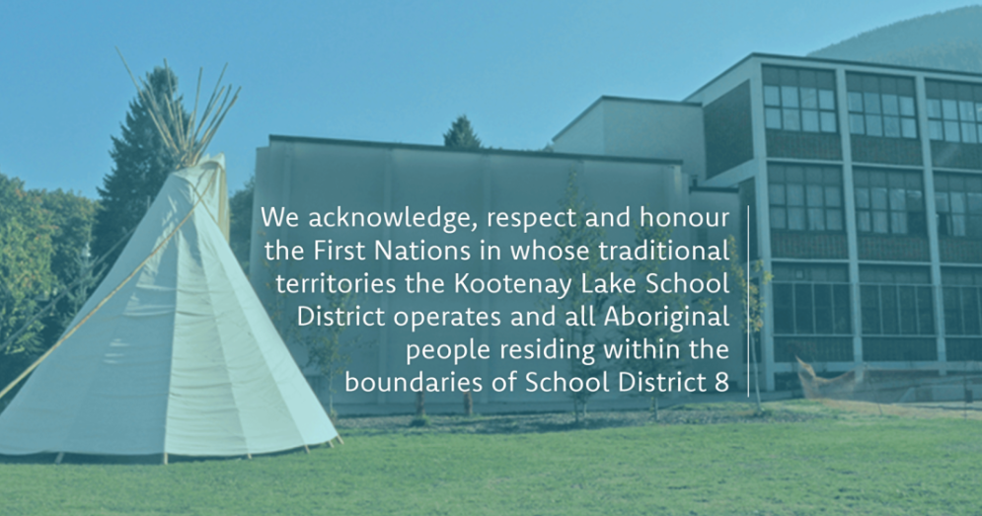
Territorial Acknowledgement

Slide 3
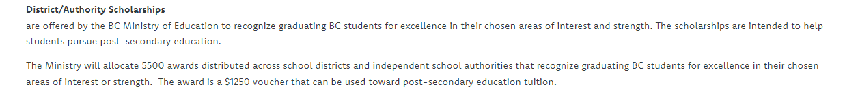
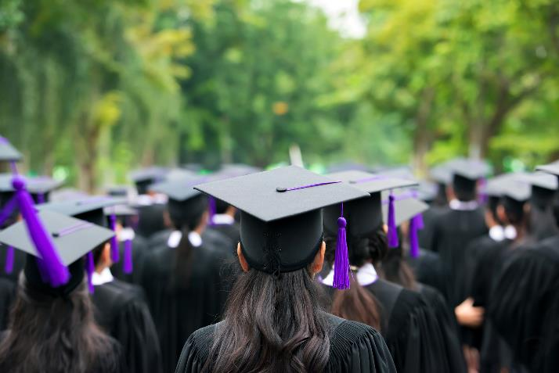
District Dogwood Overview
There are 43 DDA awards available to SD8
There are 7 other District Awards you may be applying for as well…

Slide 4
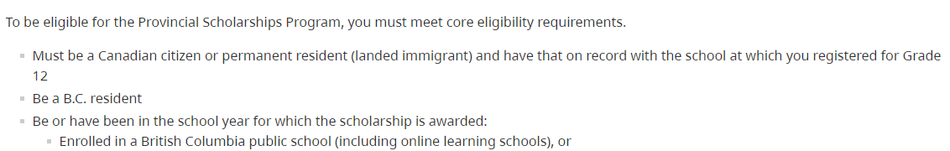
District Dogwood Eligibility
Eligibility
To earn a scholarship, students must apply and:
1. Meet the basic eligibility requirements:
2. Be enrolled as a student in SD8 Kootenay Lake (CSF 93 students apply for their Dogwood Scholarship through their school district)
There are 43 DDA awards available to SD8
There are 7 other District Awards you may be applying for as well…

Slide 5
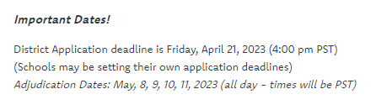
Deadlines for Dogwood
Important to Know!
Select participants will be presenting on their Capstone 12 as one presentation
There are several other district adjudicated scholarships, so please review the criteria
Ensure you have included your application form completed, reference form or reference letter, 3 year grad plan, and interim transcript – complete package goes to your school counsellor

Slide 6
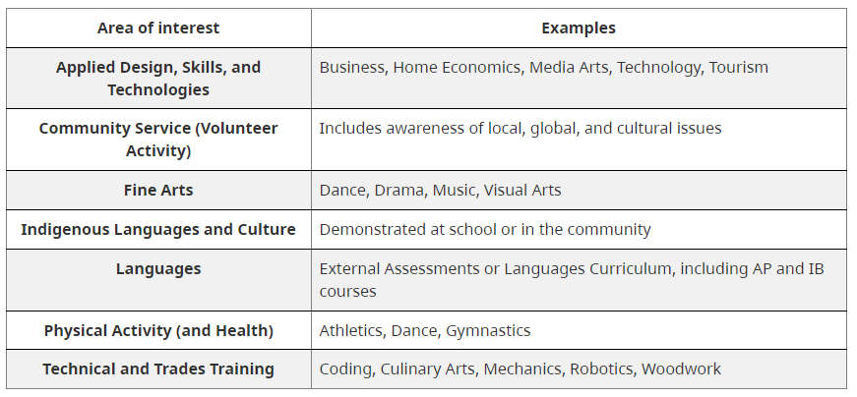
Areas of Focus for Dogwood
* Applicants must be of Indigenous ancestry.
Select participants will be presenting on their Capstone 12 as one presentation
If you are presenting on another district scholarship, let your adjudicators know, and ensure you include their criteria

Slide 7
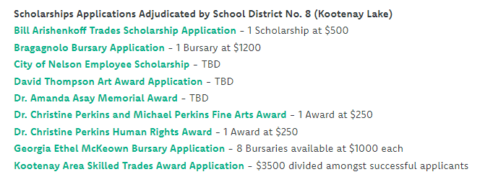
Other District Adjudicated Scholarships
Important to Know!
There are several other district adjudicated scholarships, as above, so please review the criteria and complete application forms
Students present on Dogwood ($1250), and incorporate criteria from other scholarships (Eg./ $$ financial need)
Ensure you have included your application form completed, reference form or reference letter, 3 year grad plan, and interim transcript – complete package goes to your school counsellor

Slide 8
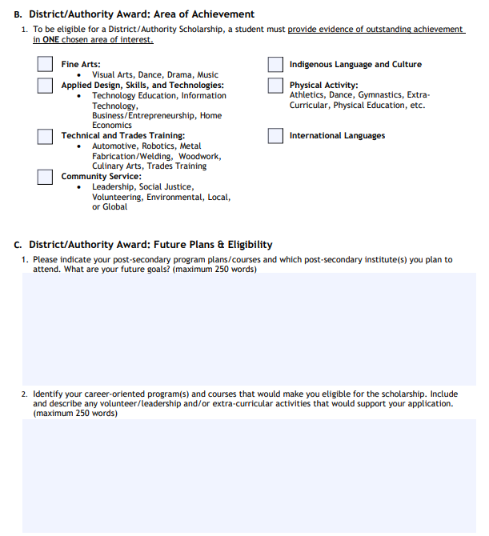
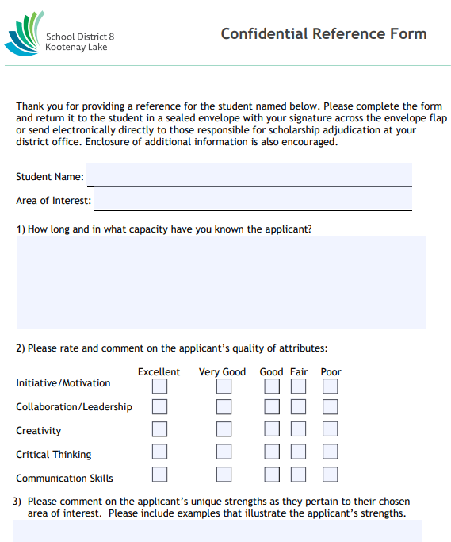
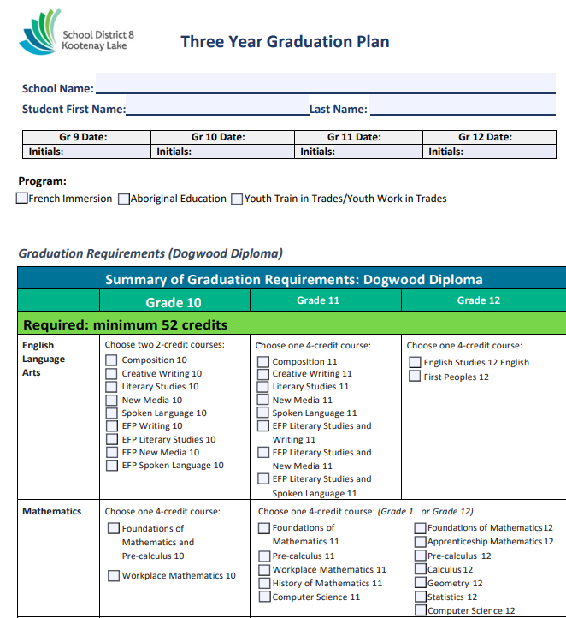
Application, Reference, & Grad Plan
Application
Reference
Grad Plan

Slide 9
Important!
Dates:
Monday, May 8th 9:00 am to 3:45 pm
Tuesday, May 9th 9:00 am to 3:45 pm
Wednesday, May 10th 9:00 am to 3:45 pm
Thursday, May 11th 9:00 am to 3:45 pm
Your school counsellors will send you or connect with you on your date and time slot.
Presentations will be via MS Teams link.
You will have 15 minutes to present, including any Q&A from the panelists.
There are 43 DDA awards available to SD8
There are 7 other District Awards you may be applying for as well…

Slide 10
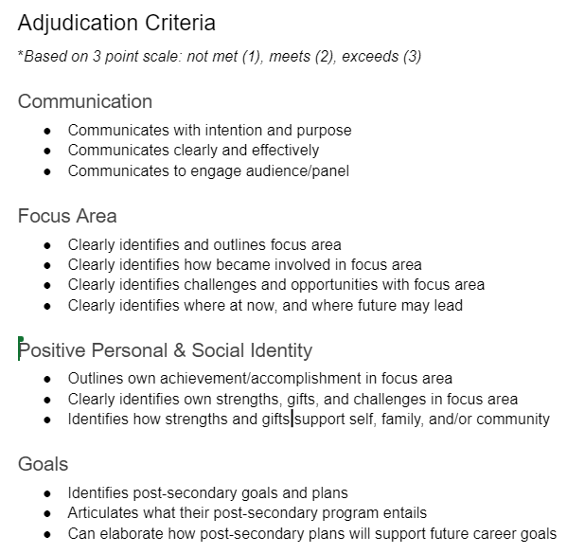
Criteria: DDA Presentation
Presentation Formats:
Self and artefacts
Self and slide deck
Self and video
Self and Digital Portfolio
*Check multi-media formats to make sure they work in advance (slide deck, video, etc.) – have a folder ready to go!

Slide 11
(Minimum) The Day Before…
Make sure you have a quiet space set aside
Check your internet connection
Make sure you have a laptop that is powered up/plugged in and test your video and sound
Load your presentation and test it out for sharing (video, slide deck, etc.)
Practice your presentation (introduction, timing, conclusion)
Practice your presentation to yourself or to someone!

Slide 12
The Day Of…
Make sure you have a quiet space set aside
“Arrive” 5-10 minutes early and be on deck!
Check your internet connection
Make sure you have a laptop that is powered up/plugged in and test your video and sound
Load your presentation and test it out for sharing (video, slide deck, etc.)
Introduce yourself, and what you will be presenting on! Include any other scholarships and/or Capstone 12
Thank the panelists/adjudicators!
Arrive 5+ minutes early and wait in the MS Teams lobby to be let in

Slide 13
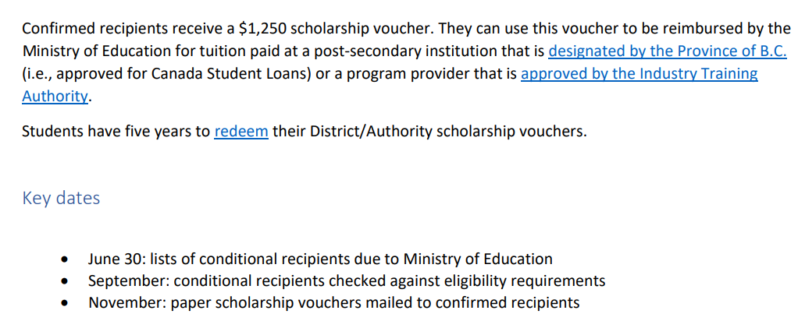
DDA Success?
*Designated post-secondary institutions: https://studentaidbc.ca/apply/designated
Students who are recipients will receive notification at Graduation Cap and Gown Ceremony

Slide 14
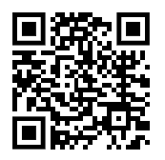
Thank you…& Good Luck!
https://www.sd8.bc.ca/parents-students/scholarships

